Slide 1
SKIN CANCER MELANOMA PREDICTION AND SKIN LESION CLASSIFICATION USING DEEP LEARNING MODELS – PHASE 2
TEAM:
Dhev Mugunddhan A - 21011101040
C Ganesh Ram – 21011101034
Agilan - 21011101011
Adithan - 21011101009
MENTOR:
Dhivya S
Shiv Nadar University Chennai

Slide 2
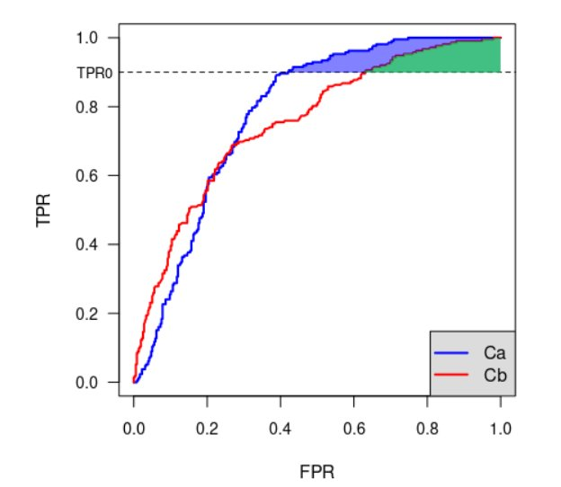
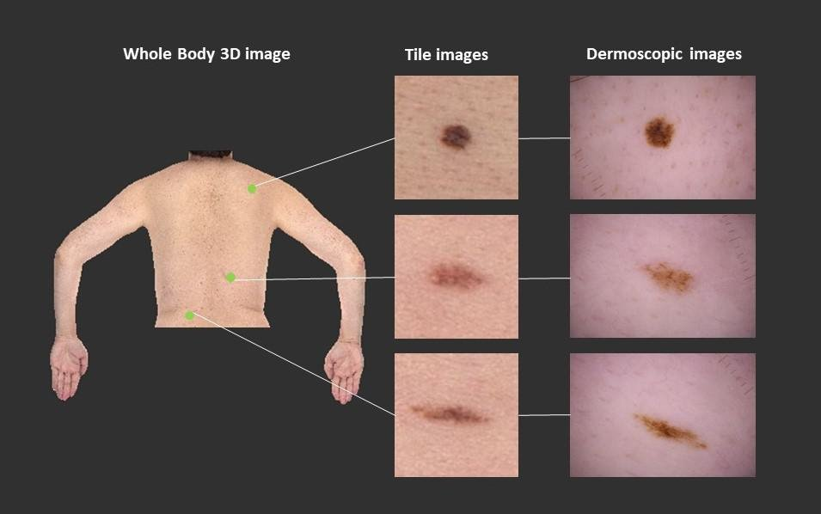
PROBLEM STATEMENT
This project aims to develop a robust, accurate, and scalable deep learning model leveraging the ISIC 2024 dataset to classify skin lesions into malignant and benign categories, addressing challenges such as:
Class imbalance
Variable image quality
Accurate lesion localization
Primary scoring metric
Submissions are evaluated on partial area under the ROC curve(pAUC) above 80% true positive rate (TPR) for binary classification of malignant examples. The receiver operating characteristic (ROC) curve illustrates the diagnostic ability of a given binary classifier system as its discrimination threshold is varied. However, there are regions in the ROC space where the values of TPR are unacceptable in clinical practice. Systems that aid in diagnosing cancers are required to be highly-sensitive, so this metric focuses on the area under the ROC curve AND above 80% TRP. Hence, scores range from [0.0, 0.2].

Slide 3
DATASET EXPLANATION
ISIC 2024 Dataset
Type of Data:
Dermascopic Images: RGB images of skin lesions.
Tabular Data: Includes patient metadata (e.g., age, sex, lesion location).
Dataset Features:
Classes: Multiple skin lesion categories (malignant and benign).
Challenges:
High class imbalance.
Varying image quality and resolutions.

Slide 4
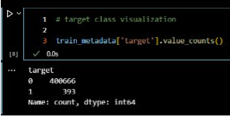
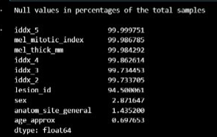
DATASET OVERVIEW: CLASS DISTRIBUTION AND MISSING VALUES
Imbalanced Classes:
Class 0 (Benign): 400,666 samples
Class 1 (Malignant): 393 samples
Missing Values:
High Missing Rate: iddx_5, mel_mitotic_index, mel_thick_mm (>99%).
Moderate Missing Rate: sex (~2.87%), age_approx (~0.69%).
Malignant Cases:
iddx_5 completely missing.
mel_mitotic_index (~86% missing), mel_thick_mm (~84% missing).
Inference: Drop or impute missing values using mean/median/predictive modeling.

Slide 5
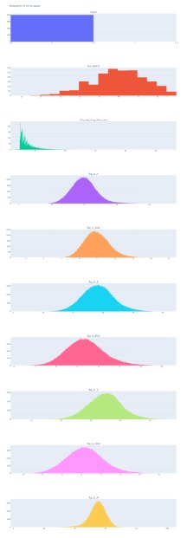
SUMMARY STATISTICS AND KEY DATA INSIGHTS
Dataset Stats:
Total Samples: 401,059
Numerical Features: 37
Mean Age: ~58 years
Lesion Size (Long Diameter): Mean = 3.93mm, Range = 1mm – 28.4mm
Key Findings from Data Visualization:
Gender Bias: More male samples than female.
Skewed Distributions: Many numerical features show positive/negative skew.
High Zero Count: Some variables appear sparse.
Inference: Consider feature transformations (log scaling, normalization) to handle skewness.

Slide 6
FEATURE RELATIONSHIPS AND SELECTION STRATEGIES
Pairwise Scatter Plot Findings:
Potential correlations among lesion characteristics.
Some attributes have high variance.
Inference & Next Steps:
Use feature selection (PCA, feature importance analysis) to retain the most predictive features.
Apply dimensionality reduction to enhance model efficiency.

Slide 7
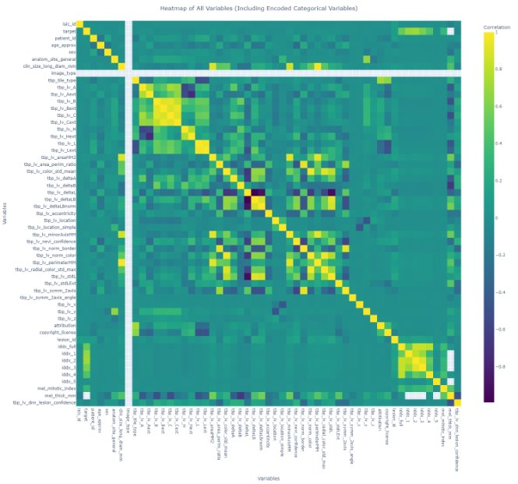
HEATMAP FOR UNDERSTANDING CORRELATION
It is evident from the heatmap that target variable doesn't have much correlation with any of the independent variables except the iddx variables which are also only present in training. But we find other correlation among the independent variables with the tbp_(fields) and mel_(fields).

Slide 8
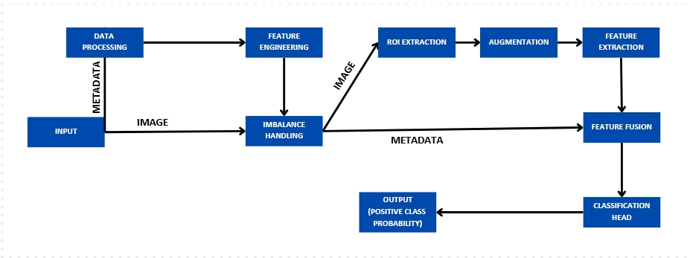
DATA PIPELINE

Slide 9
PRE-PROCESSING TECHNIQUES
HANDLING MISSING DATA
Random Forest Imputation: Used a Random Forest model to predict missing values for sex, age_approx., and anatom_site_general.
Iterative Imputer: Estimated missing values iteratively for numerical features.
KNN Imputer: Used nearest neighbors to fill missing values.
Simple Imputer: Used mean, median to fill values.
Forward fill/ Backward fill.

Slide 10
PRE-PROCESSING TECHNIQUES
FEATURE SELECTION AND ENGINEERING
Column Removal: Dropped columns to prevent data leakage, including:
Train-only columns (lesion_id, iddx_full, etc.).
Irrelevant columns (image_type, tbp_tile_type, attribution, copyright_license).
Feature Separation: Split numerical and categorical features before preprocessing.
One-Hot Encoding: Applied to categorical features with low cardinality (sex, anatom_site_general, tbp_lv_location, tbp_lv_location_simple).
Feature Hashing: Used for high-cardinality categorical features.
Scaling: Applied MinMaxScaler or StandardScaler to numerical data.
Train-Test Alignment: Ensured test dataset matched train dataset features by filling missing columns with zeros.
Final Feature Count: Processed dataset contained 52–72 features depending on preprocessing variations.

Slide 11
PRE-PROCESSING TECHNIQUES
HANDLING CLASS IMBALANCE
Random Undersampling: Majority class downsampled to 5% or 10% RandomUnderSampler.
Random Oversampling: Minority class oversampled by factors up to 500%.
SMOTETomek: Combined Synthetic Minority Over-sampling Technique (SMOTE) and Tomek Links to generate synthetic samples and remove noise.
SMOTEENN: Synthetic Minority Over-sampling Technique and Edited Nearest Neighbors) first applies SMOTE to generate synthetic samples for the minority class, uses the Edited Nearest Neighbors (ENN) technique to remove noisy and misclassified samples
Nearmiss: Near Miss is an under-sampling technique that selects samples from the majority class that are closest to the minority class samples
Stratified Splitting: Ensured class balance in train-validation splits and prevented patient ID overlap.
Class Weights Calculation: Adjusted for minority class underrepresentation:
Example: Class 0 → 0.549, Class 1 → 5.597
Used in model training (class_weight parameter)

Slide 12
PRE-PROCESSING TECHNIQUES
Image Processing Techniques:
1. Resizing: Images are resized to 72x72 pixels or 128x128 pixels for different models .Some architectures use 224x224 resizing to align with CNN backbones like ResNet .
2. Normalization: Pixel values are scaled to the [0,1] range .
Image Augmentation Techniques:
1. Random Horizontal Flip: Images are flipped horizontally with a 50% probability to improve model robustness to orientation .
2. Random Brightness Adjustment: Brightness is randomly adjusted within a ±20% range (max_delta = 0.2) to simulate different lighting conditions .
3. Random Contrast Adjustment: Contrast is adjusted randomly within a range of 0.8 to 1.2, helping the model adapt to different contrast levels .

Slide 13
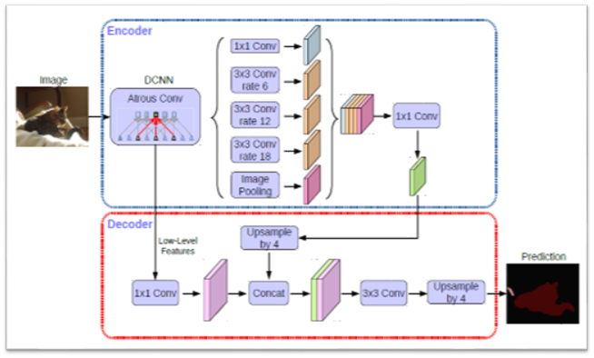
SEGMENTATION MODEL
DeepLabv3+ Model: A semantic segmentation model extending DeepLabv3 with a decoder for boundary refinement.
ASPP Module: Captures multi-scale context using atrous convolutions and global pooling.
Encoder: Uses Xception with atrous convolutions for rich feature extraction.
Decoder: Refines segmentation and enhances boundary precision.
Output: Produces high-resolution, pixel-wise segmentation maps.

Slide 14
FEATURE EXTRACTION TECHNIQUES
Image Feature Extraction
CNN Based models:
Deep Convolutional Neural Networks (DCNN): Custom architectures with Batch Normalization and Dropout for robust feature extraction.
Transfer Learning: Pretrained models (ResNet, DenseNet) on ImageNet with Global Average Pooling (GAP) to reduce trainable parameters.
Pretrained Models Used: ResNet-18, ResNet-50, ResNet-101, ResNet-152, ResNetV2-50, DenseNet-121, DenseNet-169, DenseNet-201.
Feature Aggregation: GAP applied instead of fully connected layers to maintain essential features with lower dimensionality.
Transformer based models:
ViT segments images into patches and processes them as sequences, achieving high accuracy on large datasets. Extra Feature: Captures long-range dependencies in images without convolution.
Vision Transformer for Smaller Datasets (DeiT) improves ViT’s efficiency for smaller datasets by using knowledge distillation. Extra Feature: Incorporates a distillation token to learn from a CNN teacher model, reducing data dependency.
MobileViT combines CNNs and transformers for lightweight, efficient image classification on edge devices. Extra Feature: Optimized for mobile deployment with reduced computation and memory footprint.
MedMamba is tailored for medical imaging, excelling in disease detection. Extra Feature: Adapts transformer-based architectures for biomedical data, enhancing medical image classification.

Slide 15
CLASSIFICATION HEAD
Deep Learning Models
Fully Connected Classification Head – Uses dense layers with LeakyReLU and dropout, final Dense(1, sigmoid) for binary classification.
Global Average Pooling + Dense Layer – Applies GlobalAvgPool2D, followed by Dense(1, sigmoid) for classification.
Transformer-based Classification Head – Vision Transformer (ViT) processes image patches, final Dense(1024 → 512 → 256 → 1, sigmoid).
Patch-Based Image Classification Head – Uses Global Average Pooling → Dense(512 → 256 → 1, sigmoid) for patch-wise image classification.
Tree-Based Models
XGBoost (XGBClassifier) – Uses 'binary:logistic' objective with logloss for binary classification.
LightGBM (LGBMClassifier) – Objective 'binary', metric 'binary_logloss', trained for 10,000 iterations.
CatBoost (CatBoostClassifier) – Uses 'Logloss' with 10,000 boosting iterations for binary classification.
Stacked ensemble - Combines XGBoost, LightGBM, and CatBoost, final estimator Logstic Regression produces the output probability.
Voting ensemble – Combines XGBoost, LightGBM, and CatBoost output and produces the result of the majority class output with their averages of probability as the output probability

Slide 16
OPTIMIZATION TECHNIQUES
Optimizers
Adam optimizer – Adaptive learning rate optimization with momentum, often paired with weight decay.
AdamW optimizer – Variant of Adam with decoupled weight decay for better generalization.
Nadam optimizer – Adam with Nesterov momentum for improved convergence.
RMSprop optimizer – Adaptive learning rate optimizer, useful for non-stationary objectives.
Piecewise Constant Learning Rate – Learning rate decreases at predefined step boundaries (e.g., 1e-3 → 1e-4 → 1e-5).
Exponential Decay Learning Rate – Learning rate decreases exponentially over training steps.
Loss Functions
Binary Cross-Entropy (BCE) – Standard loss for binary classification, minimizes log loss.
Binary Focal Cross-Entropy – Variant of BCE that adjusts loss based on easy/hard examples (α = 0.4, γ = 2.0).
Squared Hinge Loss – Used for margin-based classification, common in SVMs.
Logloss – Used in XGBoost, minimizes logarithmic loss for classification.
CrossEntropyLoss() – Used in deep learning classification tasks with multiple classes.

Slide 17
OPTIMIZATION TECHNIQUES
Training Techniques
Early Stopping – Stops training when validation loss plateaus, preventing overfitting.
ReduceLROnPlateau – Reduces learning rate if no improvement in validation loss after certain epochs.
Mini-batch Training – Uses small subsets of data per training step for efficiency.
Transfer Learning – Uses pretrained models (ResNet-152, DenseNet-169, MedMamba) and fine-tunes later layers.
Class Weights Computation – Adjusts loss function weight to handle class imbalance.
Stratified Splitting – Ensures train-validation split maintains class distribution.
Activation Functions
ReLU (Rectified Linear Unit) – Default activation in CNNs, prevents vanishing gradients.
Leaky ReLU – Variant of ReLU allowing small negative values, reducing dead neurons.
SELU (Scaled Exponential Linear Unit) – Self-normalizing activation, stabilizes training.
Swish – Smooth activation function improving gradient flow.
Sigmoid – Converts output to probability in the final layer for binary classification.
Weight Initializers
Kaiming Normal (He Initialization) – Optimized for ReLU-based networks.
Truncated Normal – Used in fully connected layers to prevent extreme weight values.
Layer Normalization – Normalizes layer activations, bias initialized to 0, weight to 1.

Slide 18
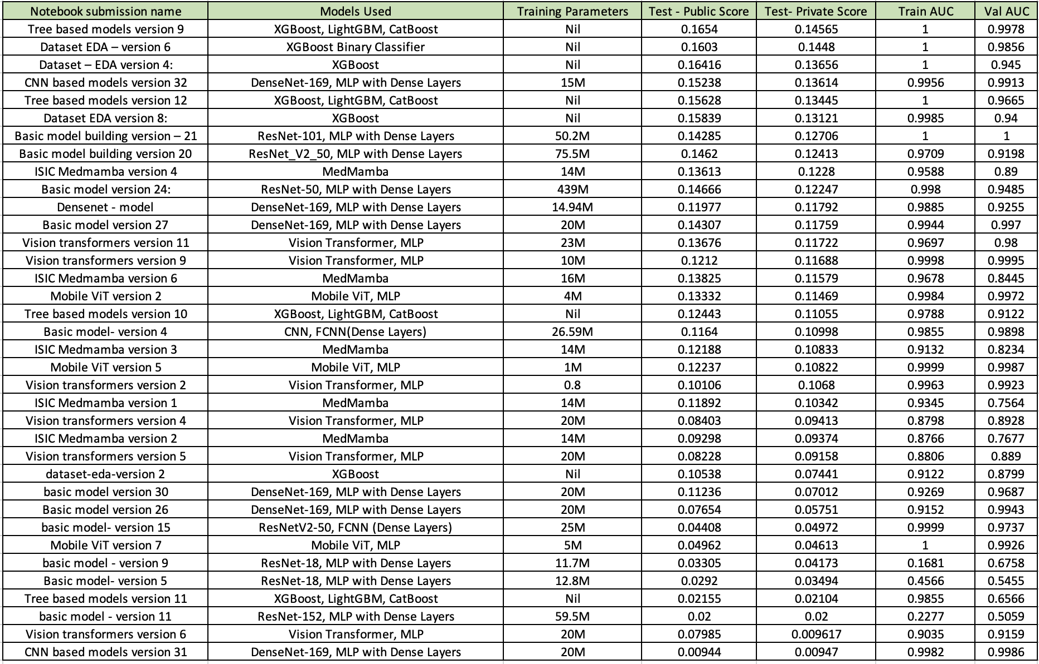
MODELS USED AND RESULTS

Slide 19
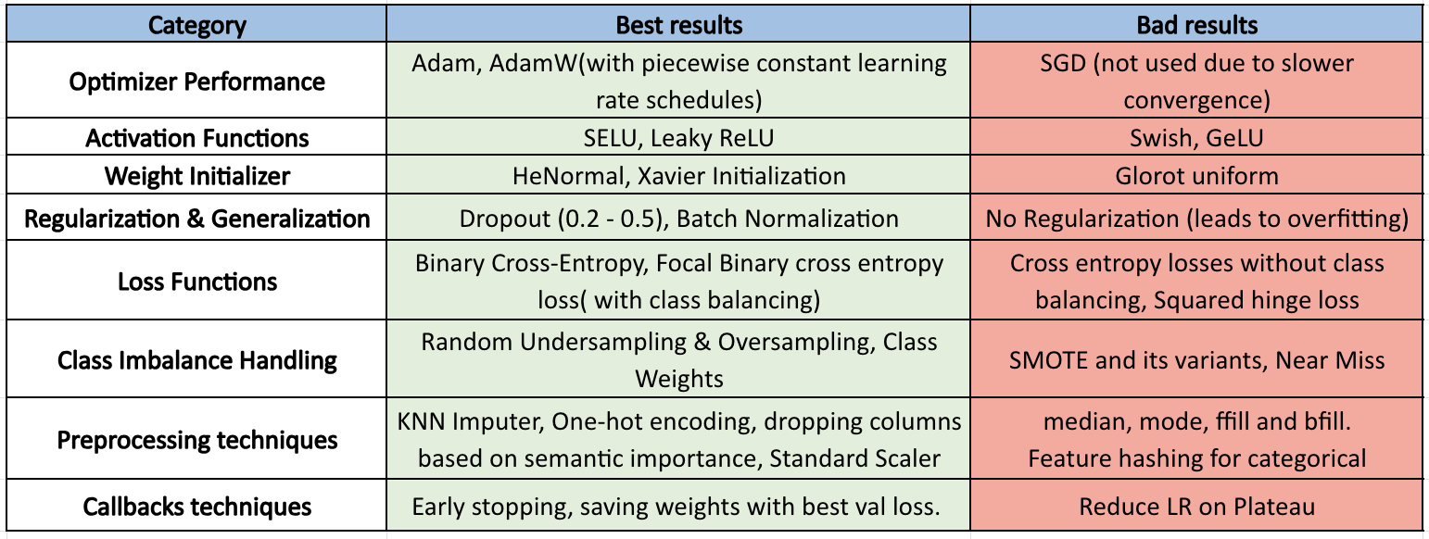
HYPERPARAMETER AND OTHER TECHNIQUES

Slide 20
MODEL FINDINGS
IMAGE ONLY
It effectively captures distinct patterns essential for accurate classification. However, the overall performance of the model plateaus beyond a certain threshold, regardless of the underlying architecture employed, whether it is a ResNet or a Vision Transformer.
IMAGE + METADATA MODEL (MULTOMODAL ARCHITECTURE)
The integration of a multimodal architecture demonstrates superior performance compared to single-modality approaches, as the incorporation of both image features and metadata enhances the model’s generalization capabilities. This results in improved performance on unseen data and challenging-to-classify samples.
ENSEMBLE APPROACH
By aggregating predictions from these diverse models, the stacked ensemble reduces individual model biases and enhances overall generalization. This results in improved performance on imbalanced datasets, reduces variance, and enhances robustness against noisy data.

Slide 21
MODEL FINDINGS
CNN BASED
Superior performance of DenseNet-169 MLP with Dense Layers, particularly in configurations with optimized training parameters. Notably, models with moderate parameter sizes (e.g., 15M–20M) achieve higher public and private test scores, suggesting an optimal trade-off between model complexity and generalization.
DenseNet-169 consistently outperforms ResNet-based architectures, likely due to its efficient feature propagation and reduced redundancy in learned representations.
In contrast, ResNet variants, despite their deeper architectures and higher parameter counts (e.g., ResNet-101 with 50.2M parameters and ResNetV2-50 with 75.5M parameters), exhibit lower partial AUC scores. This suggests that excessive parameterization may lead to overfitting, reducing generalization performance on unseen data.

Slide 22
MODEL FINDINGS
VISION TRANSFORMER BASED
Vision Transformer MLP with 23M parameters achieves the highest public test score (0.13676), while MedMamba with 14M parameters also performs competitively with a public score of 0.13613 and a private score of 0.1228. MedMamba consistently demonstrates strong performance across different configurations, suggesting its ability to effectively capture spatial dependencies while maintaining a relatively low parameter count.
Vision Transformer MLP models also perform well, particularly with parameter sizes around 10M–23M, indicating that a moderate model size leads to improved generalization.
Mobile ViT MLP models, though lightweight (1M–4M parameters), exhibit slightly lower scores, highlighting the trade-off between efficiency and predictive power.
Additionally, Vision Transformer MLP models with significantly reduced parameters (0.8M) show a substantial drop in performance, reinforcing the necessity of sufficient model capacity to learn meaningful representations.

Slide 23
THANK YOU

Slide 24
APPENDIX

Slide 25
PHASE -1 WORK
ISIC Skin lesion classification
Motivation :
Improve diagnostic accuracy for melanoma detection using deep learning.
Address challenges like class imbalance, image quality, and lesion localization.
Approach :
UNet segmentation for acquiring Region of Interest.
Orb feature extraction and xgBoost model.
DCNN feature extraction then feature fusion with ORB features using Hadamard Product and Attention based feature fusion techniques.

Slide 26
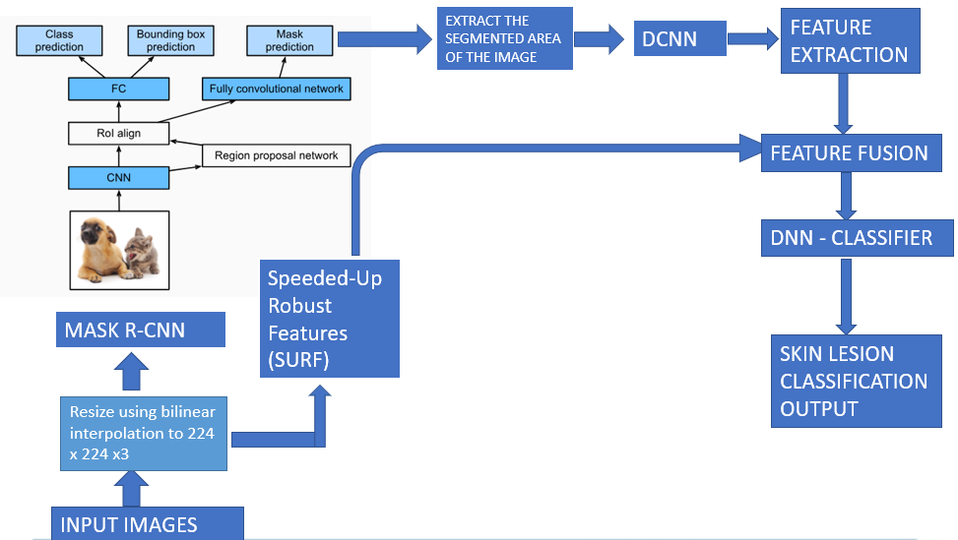
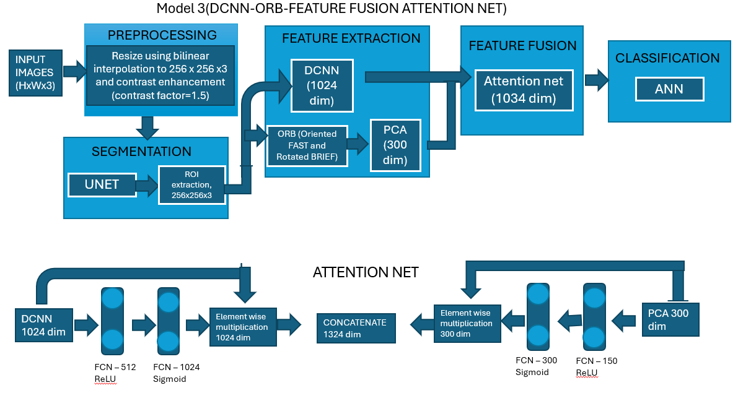
PHASE -1 WORK
Base Architectures:
Input: RGB images resized to 224×224
Models: Mask R-CNN for lesion segmentation, EfficientNet for feature extraction.
Classification: Dense Neural Network (DNN).
Novel Approaches:
Feature fusion: Combines image features (DCNN).Cross-validation: 5-fold Stratified Group KFold for robust evaluation.
Advanced data augmentation techniques for class imbalance mitigation.
Workflow:
Preprocess data (resize, normalize, augment).
Segment lesions with Mask R-CNN.
Extract features (EfficientNet) and combine with metadata.
Classify using DNN and GBDT ensemble models.

Slide 27
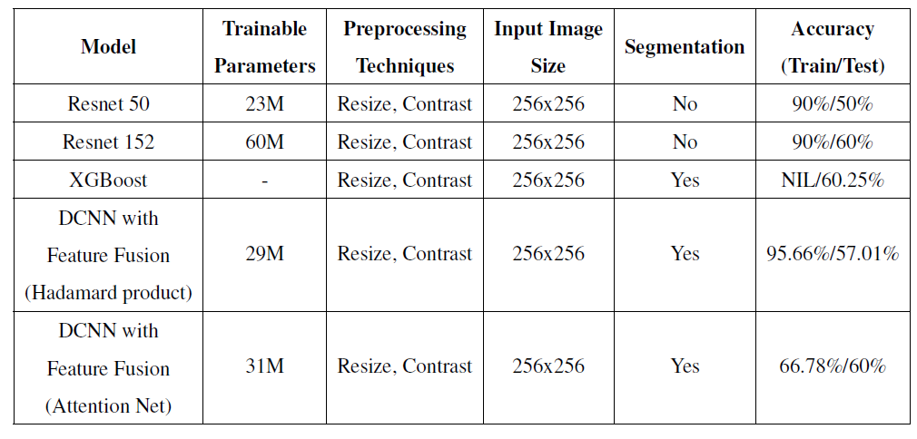
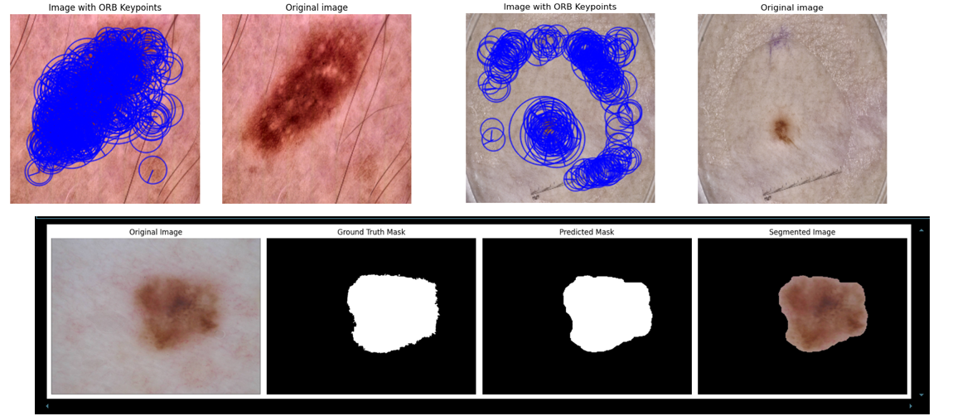
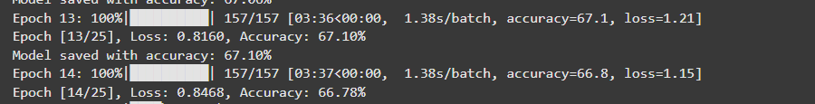
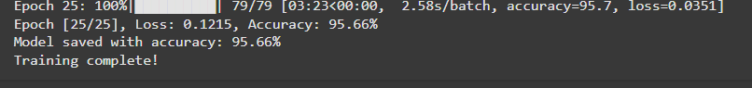
PHASE -1 WORK
results

Slide 28
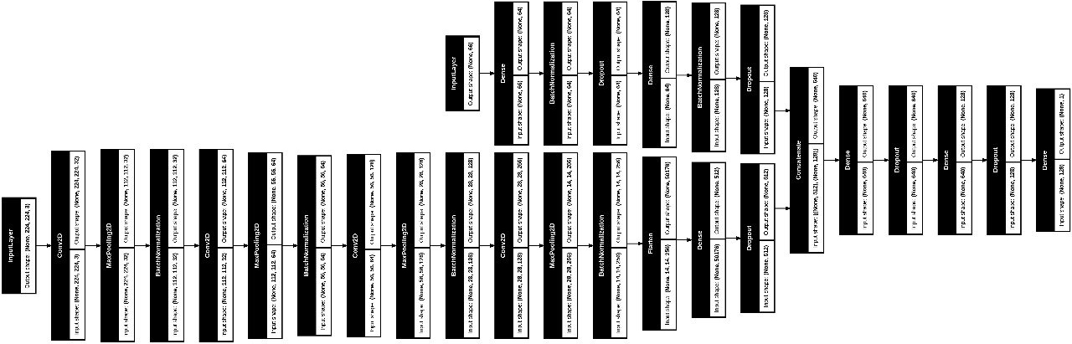
MODEL ARCHITECTURES – PHASE 2
Deep Convolutional Neural Network (DCNN) extracts spatial features from dermoscopic images, concatenated with metadata features, and fed into an Artificial Neural Network (ANN) for skin lesion classification

Slide 29
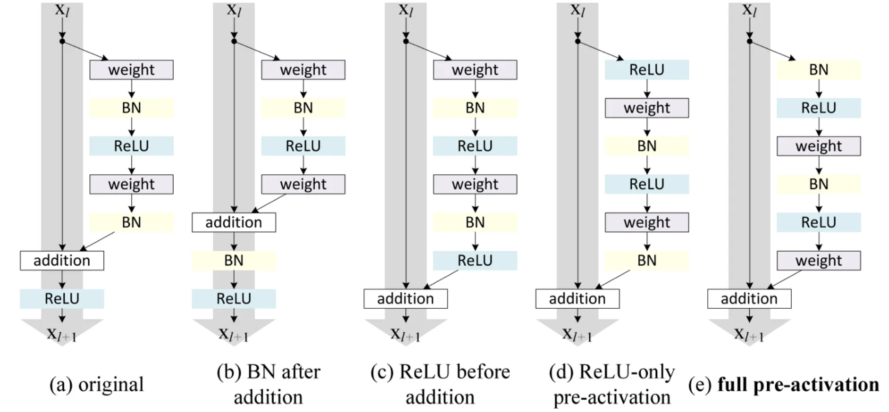
MODEL ARCHITECTURES – PHASE 2
ResNet (Original): First major deep network using residual connections. Effective but struggles with deeper architectures.
ResNet-vd (Bag of Tricks/BoTNet): Improved downsampling method, used for better feature learning in detection/classification.
ResNetV2 (KerasHub): Uses a different ordering of layers for better gradient flow, making it easier to train deep networks.

Slide 30
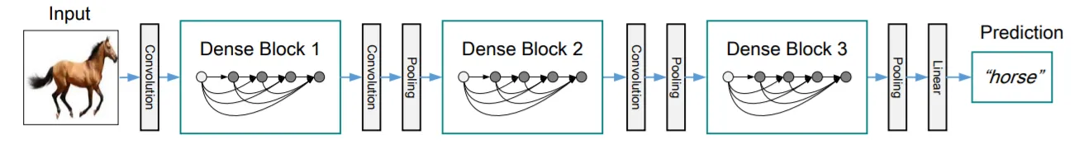
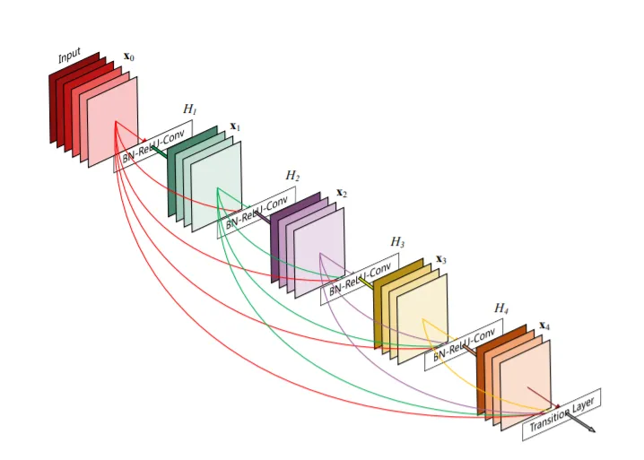
MODEL ARCHITECTURES – PHASE 2
DENSENET: They ensure maximum information flow between the layers in the network by connecting all layers directly with each other. To preserve the feed-forward nature, each layer obtains additional inputs from all preceding layers and passes on its own feature-maps to all subsequent layers. The model is shown below :

Slide 31
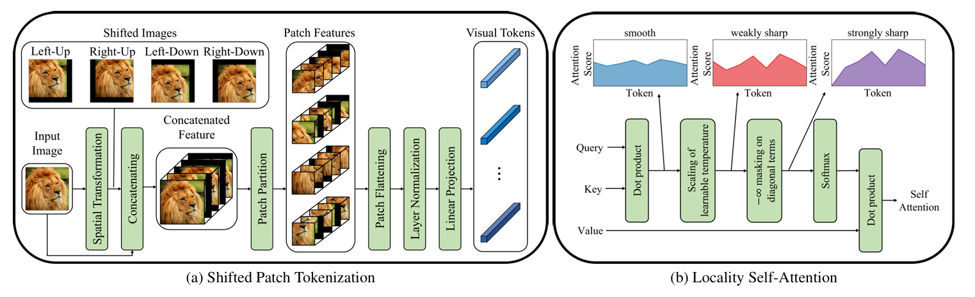
MODEL ARCHITECTURES – PHASE 2
Vision Transformer for Small-Size Datasets

Slide 32
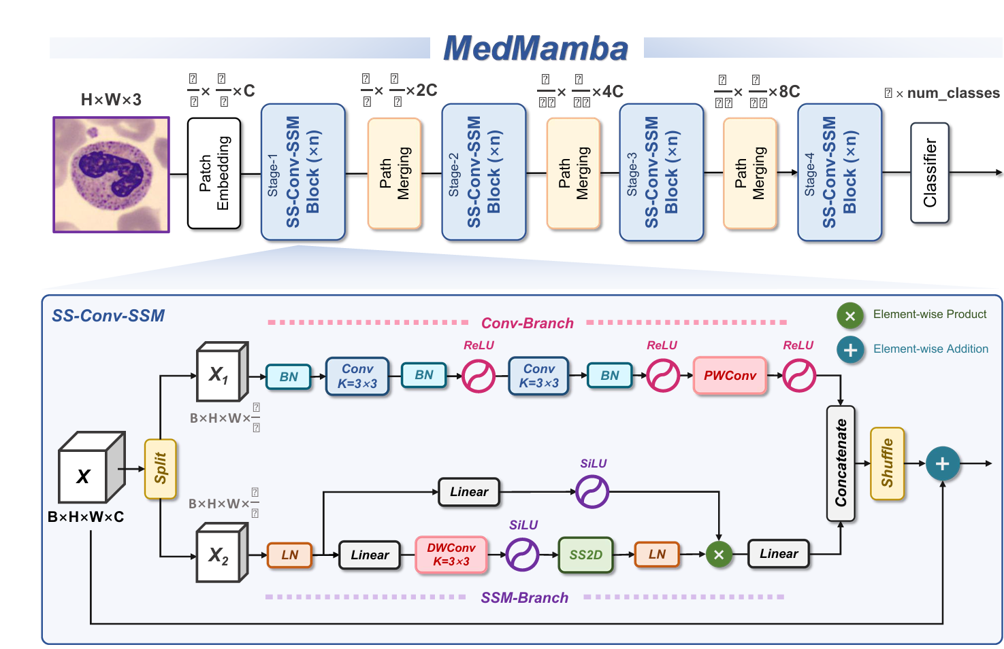
MODEL ARCHITECTURES – PHASE 2

Slide 33
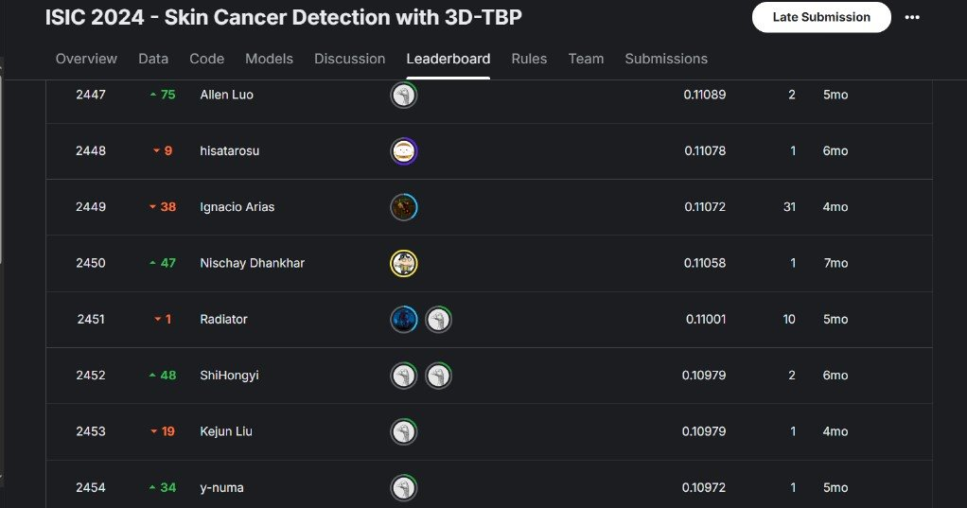
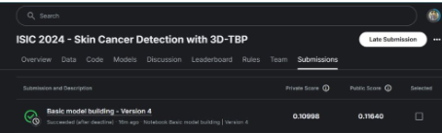
INITIAL RESULTS

Slide 34
LINKS AND REFERENCES
https://ieeexplore.ieee.org/abstract/document/8599078?casa_token=L-P9Wra7nEwAAAAA:JjHCRe_UAMitXcu-LqiGaKcaL_KGYFK4n5BNyfNufwFggf-howRGiPYXmrX-jHuA-G4iH7Iy1A
https://www.sciencedirect.com/science/article/pii/S2590005619300049
https://link.springer.com/chapter/10.1007/978-3-030-78191-0_51
https://ieeexplore.ieee.org/abstract/document/9121248
https://ieeexplore.ieee.org/abstract/document/8363547?casa_token=NJ5KP-pmlNEAAAAA:UNXmGIvxVlXZAODf1j4rLqkxuZwXOc2qIaIcqDDNs7jafNppj3n4dNHei8aDpTc883NCvPnBuQ
https://github.com/cgrundman/isic_challenge_2024/blob/main/isic-efficientnet.ipynb
https://github.com/wissemkarous/ISIC_Competition-2024/blob/main/ISIC2024-TabularData.ipynb
MedMamba - 2403.03849
Mamba - 2312.00752
Vision Transformer for Small-Size Datasets - 2112.13492v1
Resnet V2 - 1603.05027
Bag of Tricks for Image Classification with Convolutional Neural Networks - [1812.01187] Bag of Tricks for Image Classification with Convolutional Neural Networks
Densely Connected Convolutional Networks - [1608.06993] Densely Connected Convolutional Networks
A STACKING FRAMEWORK FOR THE PREDICTION OF BINARY CLASSIFICATION PROBLEMS - A STACKING FRAMEWORK FOR THE PREDICTION OF BINARY CLASSIFICATION PROBLEMS | Semantic Scholar

